Slide 1

Telling an Effective Success Story
October 25, 2022

Slide 2

I’m Heather!
Senior analyst for social and behavioral health at ASTHO.
Notes:
I serve as an information and policy resource for injury and violence prevention programs.
The Association of State and Territorial Health Officials is a nonprofit organization committed to supporting the work of state and territorial public health officials and furthering the development and excellence of public health policy nationwide
ASTHO members are the chief health officials from each of the 50 states, Washington, D.C., five U.S. territories, and three Freely Associated States.
ASTHO also supports peer communities of state and territorial health leaders and senior executives in health departments who work with the over 100,000 public health professionals employed at state and territorial public health agencies.
ASTHO’s primary functions are to:
Develop strong and effective public health leaders.
Improve public health through capacity building, technical assistance, and thought leadership.
Advocate for resources and policies that improve the public’s health and well-being.

Slide 3
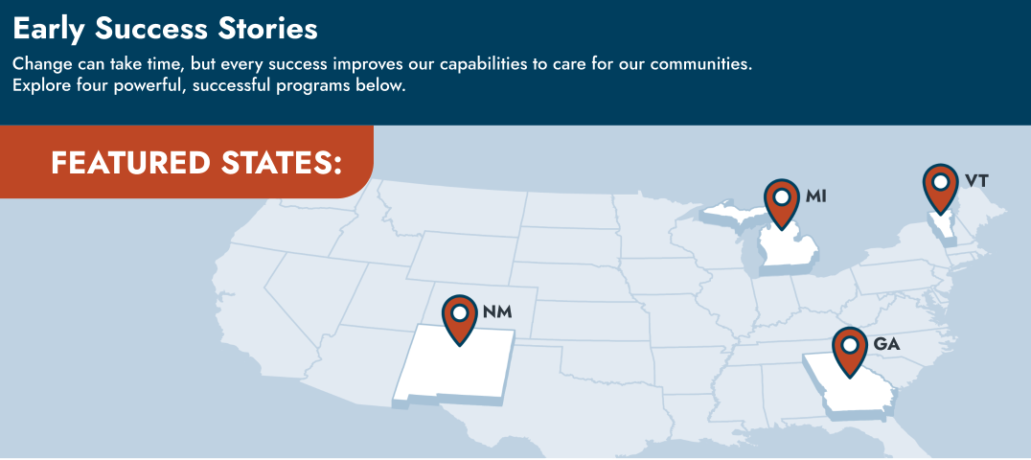
Project Overview
Notes:
This past year ASTHO has worked in collaboration with the CDC, Banyan Communications, and four states to develop impact storytelling products
The four states are New Mexico, Michigan, Georgia, and Vermont
The purpose of this project is to build capacity of state health departments to communicate the impact of their funded injury and violence prevention programs
The programs – CSP, comprehensive suicide prevention program, FASTER, Firearm Injury Surveillance Through Emergency Rooms, PACE D2A, Preventing Adverse Childhood Experiences: Data to Action
To better understand and tell the stories of hope and success from these newly funded programs.
These products will garner interest, encourage partnership, and demonstrate need for continued support among policymakers.

Slide 4

I’m
Becca!
Senior creative content specialist at Banyan Communications.
Notes:
I’m a senior creative content specialist at Banyan Communications, a health communications agency based in Atlanta. What that means is that I write things. Lots of things.
At Banyan, I’ve led content planning and creation for numerous high-budget contracts on violence and injury prevention, substance use disorder treatment and prevention, early relational health, adverse childhood experiences, and more. I’m also a professional educator with a masters degree and more than 750 hours in the classroom.
And I led content production on ASTHO’s recent success stories project, which is why we’re here!

Slide 5
Learning Objectives
By the end of this webinar, you should have a better understanding of how to:
Determine what effect you want your success story to have.
Identify early successes that can impact partners, policymakers, and the public.
Define stories in innovative, unexpected ways to engage and influence audiences.

Slide 6
What is a success story?
An opportunity
An open door
A spark
Notes:
Success stories are communication tools for sharing achievements and progress.
They are are opportunities to highlight project/organization/community progress to potential funders, policymakers, partners, and the public. They can demonstrate the value of your work and the impact it has, which can help secure funding, new or renewed partnerships, community interest, and more.
When success stories are effective, they can educate, inspire, and motivate stakeholders.
Success stories can also be the spark for other organizations, states, and programs who might be interested similar topics, methods, or funding your program uses.

Slide 7
What is a success story?
Back to basics
How to use success stories
Traditionally a narrative
Written in active voice
  Can go far beyond just words!
Contain details of program and community progress and achievements
Project updates
Share with funders, legislators, target audiences, general public, etc.
Share with other researchers and state entities
Share with other partners
Notes:
Success stories are, traditionally, narratives. They are written in an active voice (so, for example, “CDC provided funding for X, Y, and Z” as opposed to “The funding for X, Y, and X was provided by CDC), but stories can go far beyond simply using words on a page. We will talk more about that later. And success stories contain details of program and community progress and/or achievements. These are your successes. We will define what we mean by “success” in just a few moments.
There are many ways you can use success stories. For example, you can incorporate them in or use them as project updates to stakeholders and partners. You can share your success stories with funders, legislators, target audiences, and the general public. You can share your stories with other researchers and state entities in order to spark interest and conversation–perhaps another state is dealing with similar issues, or might be looking for projects related to topic areas with which they are struggling. Or perhaps someone at a related organization may want to start a partnership based on the successes of your past.

Slide 8
Type in the chat!
What are some examples of effective success stories you’ve come across in your work?
How do you communicate with your funders/audience/partners?
Notes:
A minute 30, maybe 2 minutes.
Robin monitor the chat
Anything you may have done with your organization or one you have viewed that made you want to learn more?

Slide 9
So, how do you craft an effective success story?
Notes:
So, how do you craft an effective success story?
Let’s first define those last three words.

Slide 10
What do we mean by effective?
producing or capable of producing a desired result.
To craft a story that will produce the desired result, we first need to define our desired result.
Notes:
When we say effective, we mean something that produces or is capable of producing a desired result. So, in order to craft a story that will produce the desired result, we first need to define our desired result.

Slide 11
What do you want your story to do?
Gain more funding?
Influence legislation?
Improve data collection?
Collaborate with new partners?
Determining your desired outcome is an essential part of creating an effective success story.
Notes:
What do you want your story, and thus your audience, to do? Do you want to gain more funding? Do you want to influence legislation? Do you want to improve data collection? Do you want to collaborate with new partners? Determining your desired outcome is an essential part of creating an effective success story.

Slide 12
Figuring out your why
Headline
News
Elevator
Pitch
Vision for the Future
What great headline would you want to see about your program?
How would you describe recent program success in under one minute?
What is your ideal vision for your program’s future? Why?
ASTHO recently launched a success story hub, which allows members to…
“Success stories help secure funding for public health prevention efforts”
By 2030, the success story hub will…
Notes:
Figuring out your objective can be a little tricky, but here are three guiding questions you can ask yourself that can help you get started thinking.
What great headline would you want to see about your program? We asked ASTHO this when we were doing our first few meetings with them. Heather, what did you come up with?
What about an elevator pitch? How would you describe recent program successes in under one minute? Heather, how would you describe the ASTHO success story hub?
Another useful question is what is your ideal vision for your program’s future? Why? Heather, give it another run. By 2030, the success story hub will…
News Headline
Success stories help secure funding for public health prevention efforts.
Elevator Pitch
ASTHO recently launched the success story hub, which allows members to communicate the impact of their programs.
Vision for the future
By 2030, the success story hub will host stories from at least half of all states, territories, and freely associated states.

Slide 13
Type in the chat!
What would your headline be?
How would your elevator pitch go?
What is your vision for success?
Notes:
Let’s take a moment for you to consider and type just a headline for your program into the chat. I’ve left the other questions up for you to consider, but let’s focus on the headlines for now.
Heather, what headlines are you seeing?

Slide 14
What do we mean by success?
the accomplishment of one's goals.
Flexibly redefine success, especially in the early stages of a project.
Success is progress, and progress isn’t always linear.
Notes:
One definition of success is the accomplishment of one’s goals, but I want us to forget that definition. I want us to flexibly redefine success, especially when it comes to successes in the early stages of a project. Instead, I want us to think of success as being progress, and I want us to remember that progress isn’t always linear.
Anything you can count as progress can count as a success. Let’s look at a few examples from our ASTHO success stories.

Slide 15
What counts as progress?
Michigan - CSP
  The Life You Save campaign
  Hiring a dedicated epidemiologist
  Community partnerships
Vermont - CSP
  Suicide prevention in emergency departments
  Shortening lag-time for death data reporting
  Community partnerships
Process is progress!
New Mexico - FASTER
  Clarifying definitions
  Internal collaboration
  Community partnerships
Georgia - PACE:D2A
  Localization of ACEs prevention strategies
  Surveillance activities
  Community partnerships
Notes:
Our four success story states were Michigan, Vermont, New Mexico, and Georgia. Michigan and Vermont both working under CDC’s Comprehensive Suicide Prevention initiative, which enables states to implement and evauate a public health approach to suicde prevention. In New Mexico, the Firearm Injury Surveillance Through Emergency Rooms (or FASTER) initiative provides surveillance data in near-real time on emergency visits for nonfatal firearm injuries. And in Georgia, the Preventing Adverse Childhood Experiences: Data to Action program supports the monitoring and prevention of adverse childhood experiences, or ACEs.
The states, even Michigan and Vermont, which were under the same initiatives, had very different processes and successes, so we highlighted and told those success stories in different ways.
I do want to point out that all of these states really counted their community partnerships as major successes. Each partnership was unique, but each partnership represents progress.

Slide 16
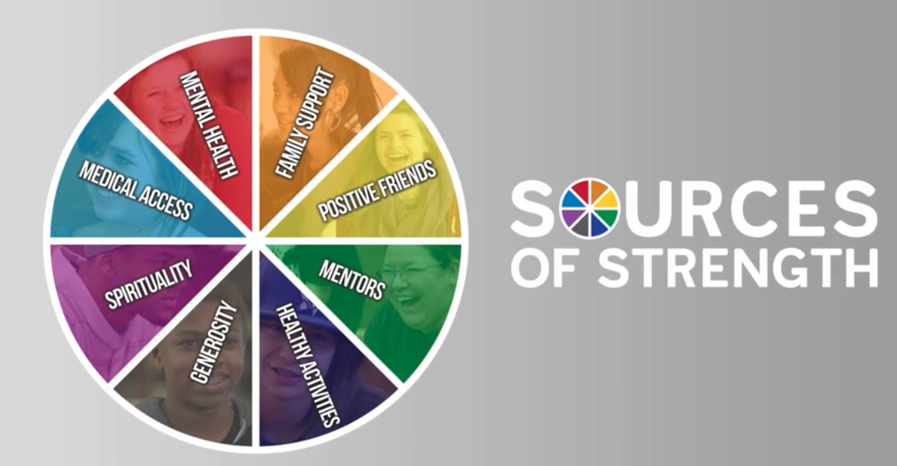

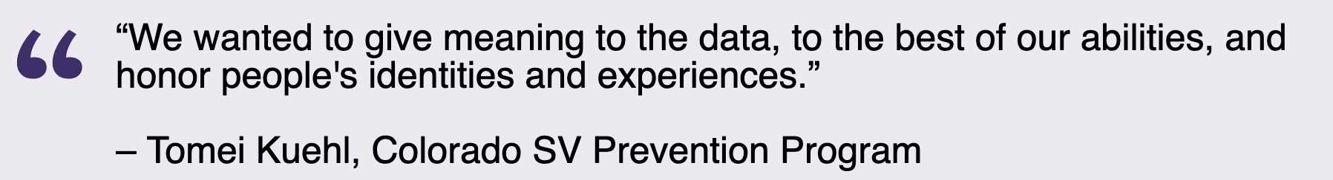
Early success can be hard to conceptualize, but remember:
Progress is success.
Notes:
Early success can be hard to conceptualize, so I want you to remember that progress is success.
Here’s another related example from CDC’s Veto Violence program.
The Colorado Sexual Violence (SV) Prevention Program sought to evaluate whether the [click] Sources of Strength (Sources) approach to suicide prevention, which boosts upstream protective factors, could also prevent sexual violence perpetration and victimization.
After completing data collection, the research team realized the survey tool was limited in terms of accurately capturing some categories including gender identity, gender fluidity, and racial identity.
[Click, read text]
The team decided to halt major outcomes analysis and reconfigure the data analytic plan associated with gender identity. Team members worked together to create identity categories that were more inclusive of each participant's identities.
[Click]
Prioritizing data inclusivity also required slowing down to move forward. The team took 4-5 months to get the categories and reasoning right before returning to data analysis. The team was willing to adjust when something was not working. That meant switching to a new lead data analyst/statistician who better matched the project’s goals and values.
[Click]
The Colorado SV prevention program correctly frames all of these things as successes, because each of these steps indicates progress.
Okay, so that’s success.

Slide 17
What do we mean by story?
facts pertinent to a situation in question.
The story is the journey of the project.
Notes:
A story can be a sequence of facts pertinent to a situation in question, but that’s really boring. Our story is the journey of the project. By redefining our understanding of story to be more flexible and inclusive, we allow ourselves to reconceptualize what we are “allowed” to tell our communities about.

Slide 18
Structuring a Story
Beginning
Middle
End
The hero sets out on a quest.
The hero overcomes obstacles.
The hero achieves their objective.
Notes:
Traditional stories often follow a three act structure - beginning, middle, and end. I’m wildly oversimplifying here, but let’s go with it.

Slide 19
Building ASTHO Success Stories
Defining
Effect
Finding Successes
Crafting
Stories
ASTHO wanted to inspire public health organizations to create and share innovative success stories that celebrate progress and motivate change.
Through interviews with the selected states, we focused on meaningful partnerships and progress in the face of challenges.
Adapted the classic 3-part story arc into a more fitting process:
Issue
Approach
Progress
Incorporated design, audio, video, and interactive web development.
Notes:
To build ASTHO’s success stories, we needed to define the effect we wanted these stories to have. [CLICK] ASTHO wanted to inspire public health organizations to create and share innovative success stories that celebrate progress and motivate change.
We needed to find the flexibly defined successes we wanted to highlight.{CLICK}
We did this through interviews with selected states. We focused on meaningful partnerships and progress in the face of challenges like the COVID-19 pandemic.
And we needed to craft the stories. [CLICK]
This is where we adapted that three part arc we just talked about. Instead of having a beginning, a middle, and an end, we focused first on the issue, then on how the program was approaching the issue, and then on the progress the program had made.
Once we had our stories crafted, we incorporated design, audio, video, and interactive web development to really engage our audiences as best we could.
Let’s talk more about our three part process.

Slide 20
Structuring a Story
Issue
Define the problem by explaining the issue in a way that provides context for those who may not have it.
Notes:
We started by defining the problem. You can do that by explaining the issue your program is working on in a way that provides context for those who may not have it. You are an expert in your work, but I’m not. Most of the people engaging with your story won’t be experts. So you need to give them the context they require to properly appreciate the impact and meaning of the successes you’re going to be sharing.
Let me give you an example.

Slide 21
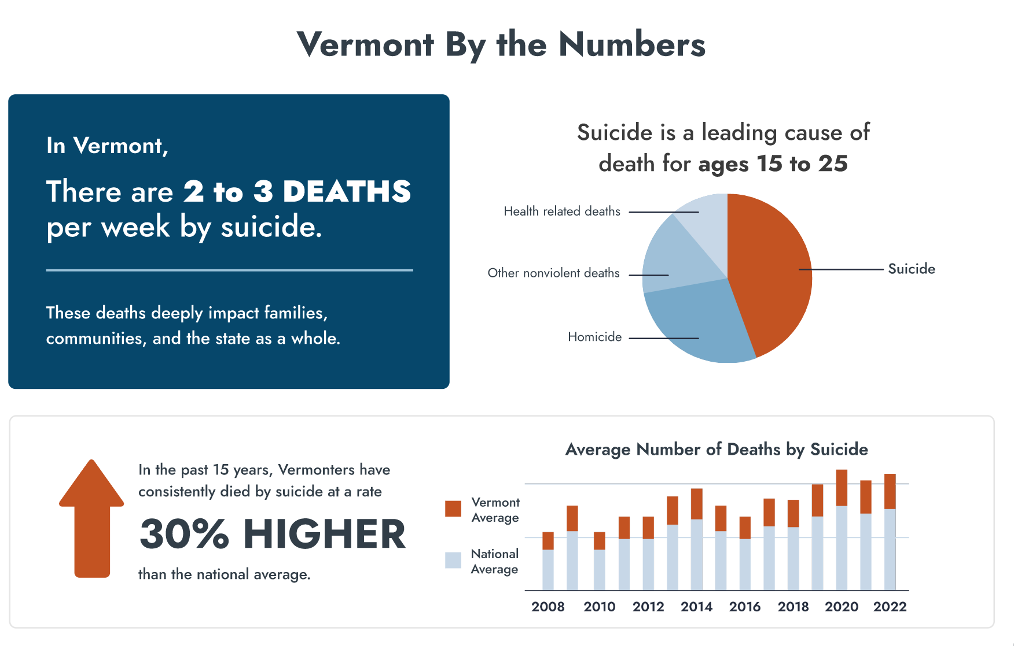
Notes:
The Vermont Comprehensive Suicide Prevention program (CSP) addresses the high rate of sucide in the state. A lay person may not know that suicide is such a prevalent cause of death, or that the rate of suicide is higher in Vermont than the national average. They will need to know this to fully understand and appreciate the work the Vermont CSP does. We added even more context through the use of data visualizations and other graphic interest. I do want to note that there may be changes to these graphics and numbers as we move forward - it isn’t a final draft.

Slide 22
Structuring a Story
Issue
Approach
Define the problem by explaining the issue in a way that provides context for those who may not have it.
Introduce the way your program addresses (or plans to address) the issue by explaining the approach.
Notes:
After you explain the issue and define the problem, you need to introduce the way the programs address, or plan to address, the problem by explaining the program’s approach.

Slide 23
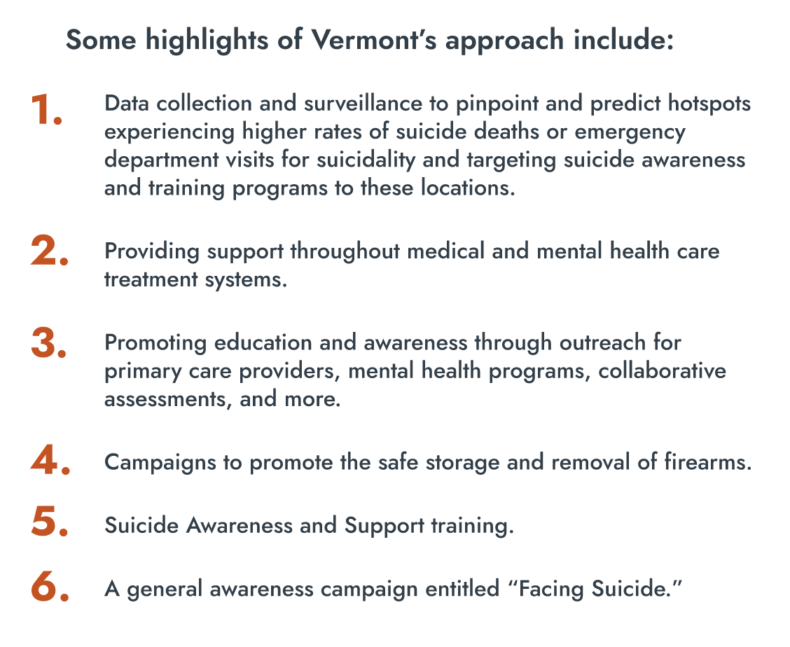
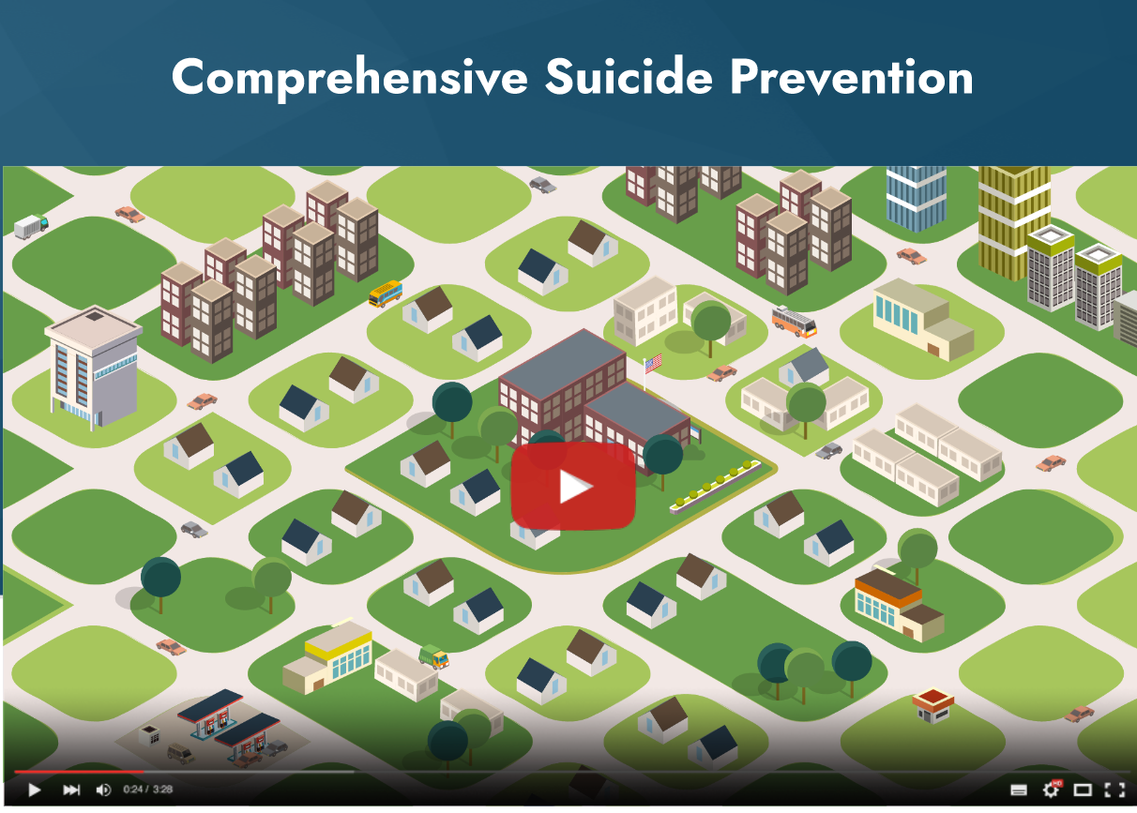
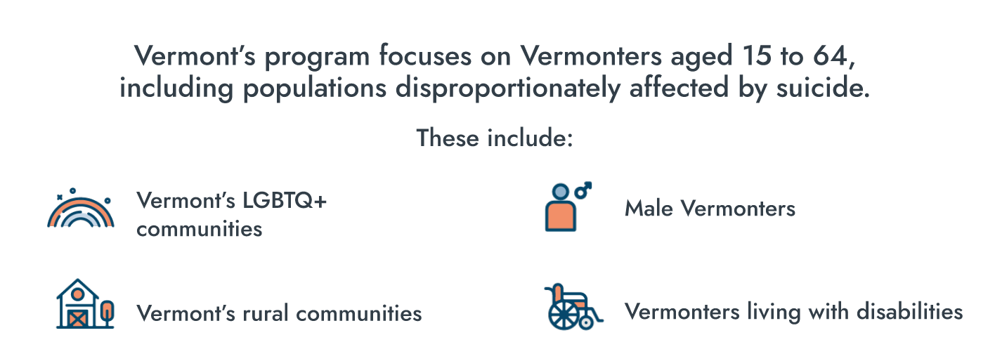
Notes:
Going back to our Vermont example, we explained the CSP approach through an animated video. Then we used text and visuals to explore some of Vermont’s specific focuses in the CSP, and highlighted some of the Vermont approach. All of this builds on the context provided when we explained the issue–it show’s how the approach addresses the issue at hand. Again, all of these might change!

Slide 24
Structuring a Story
Issue
Approach
Progress
Define the problem by explaining the issue in a way that provides context for those who may not have it.
Introduce the way your program addresses (or plans to address) the issue by explaining the approach.
Describe the steps taken, partnerships built, data collected, changes made, funds received, lessons learned, etc. to show the progress your approach is making toward solving the issue.
Notes:
So now we understand the issue, we understand the approach. Here’s where we get to the success! Your progress. Describe the steps taken, the partnerships built, the data collected, the changes made, the funds received, the lessons learned, the process of your project to show the progress your approach is taking to solving the issue.

Slide 25
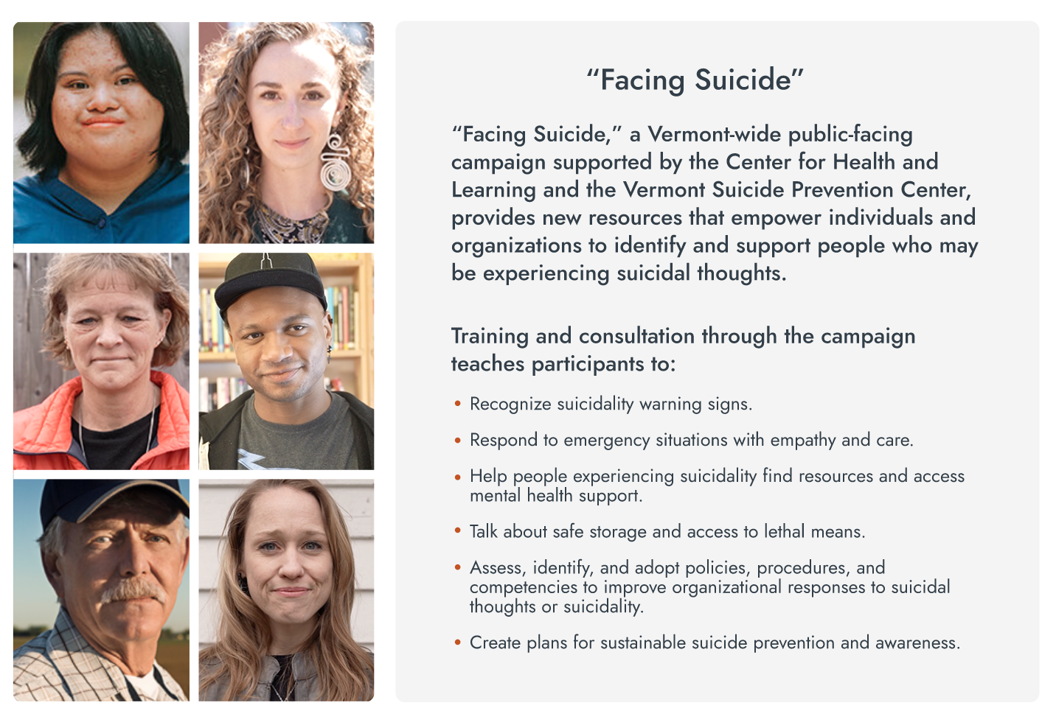
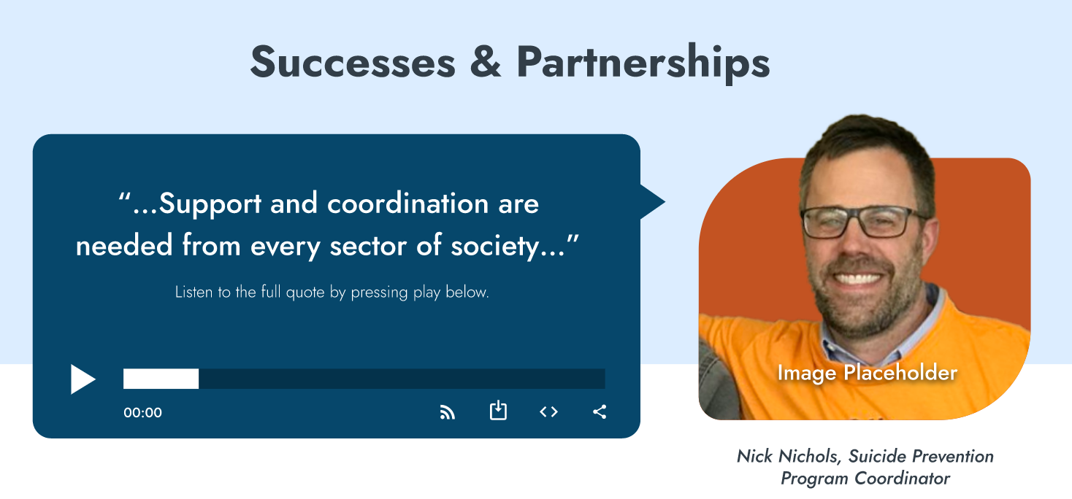
Notes:
In Vermont, we focused on how essential the CSP’s partnerships are to its success. We incorporated audio and visual interest by recording quotes from program staff, partners, and more. [CLICK]
We also highlighted their “Facing Suicide” campaign, providing both details and visual interest that can inspire and motivate the story’s audience.

Slide 26
Always end with hope.
The best stories leave you wanting more.
With success stories, you can provide a vision for the future of your project, issue, and state.
Notes:
So, how do we end a success story? [CLICK]
My advice is to always end with hope.
[CLICK]
The best stories leave you wanting more. Effective success stories will help you achieve your defined goal, and the best stories leave you wanting more. You can provide a vision for the future of your project, issue, and state in these success stories. By doing so, you can help your funders, legislators, partners, and public envision a future where your issue has been successfully addressed, and that can help motivate them to provide funding, change laws, get involved, and more.

Slide 27
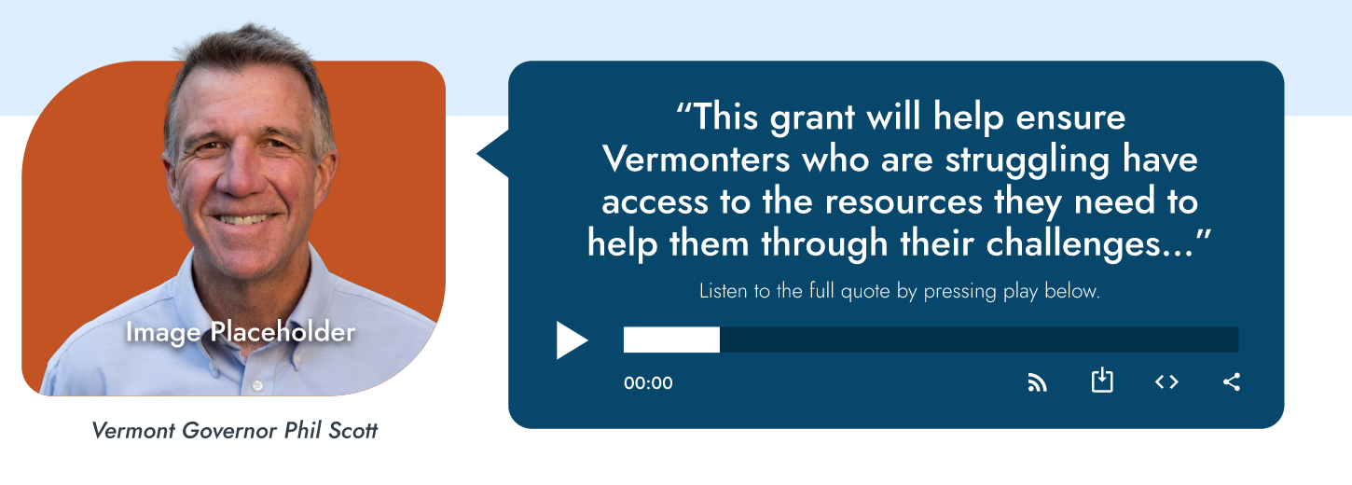
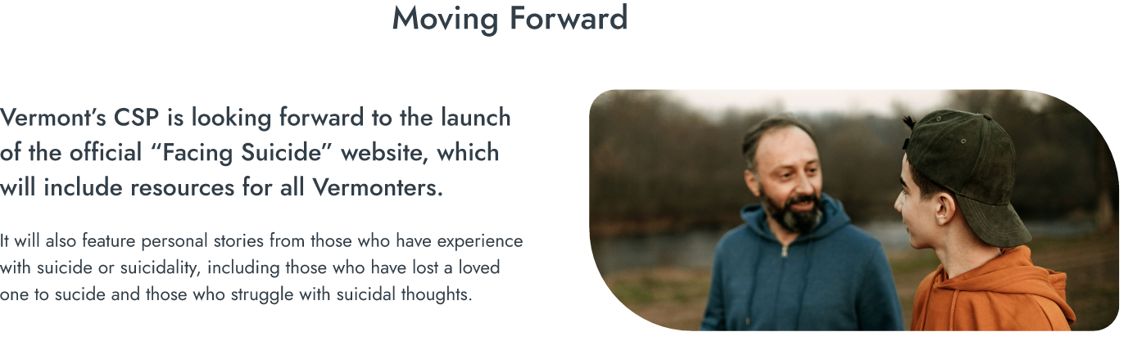
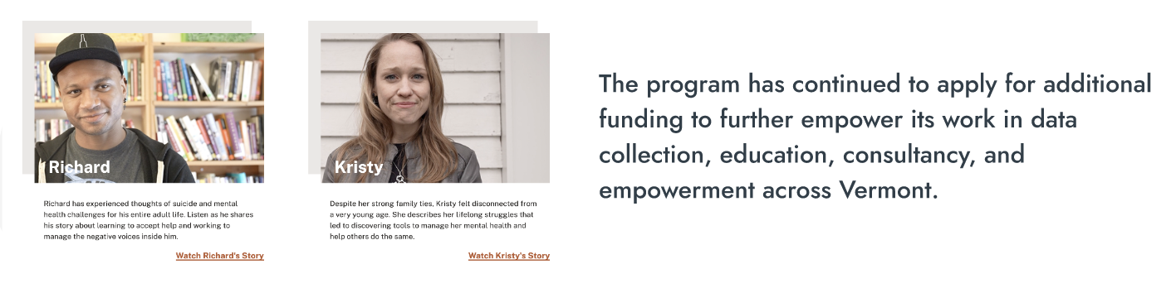

Notes:
For Vermont, we highlighted a vision for the future with an audio quote from Vermont governor Phil Scott. [CLICK]
We then laid out the CSP’s immediate and long term next steps.
And we finished with a hopeful, true statement: [CLICK]
Together, we can prevent suicide.

Slide 28
Think outside the (text) box
Engage your audience and manipulate their emotions!
Audio
  Quotes, interviews, sound-bites, field recordings, etc.
Video
  Site visits, interviews, field recordings, testimonials, etc.
Graphics
  Photographs, illustrations, infographics, data visualizations, etc.
Anything else you can think of!
Stories do not need to be (and should not be) simply words on a page!
Notes:
Traditionally, we think of stories as being words written on a page. Success stories can often feel like white papers or other relatively dry documents, but they don’t have to be if we can think outside the text box. Writers, and you are all writers to some degree, are always aiming to [CLICK] engage their audience and manipulate their emotions. We can do that with words, yes, but we can also get innovative with our success stories. For the ASTHO success stories, we were able to incorporate [CLICK] audio [CLICK]. You can pull in recorded quotes, interviews, sound-bites, field recordings, anything!
[Click]
We also incorporated videos, and you can, too! [CLICK] Record site visits, interviews, field work, testimonials, and more.
We used a lot of [CLICK] graphics, [CLICK] like photographs, illustrations, infographics, data visualizations, and more.
[CLICK]
So get creative. You can use anything else you can rethink of! Any way you can tell your story and reach your intended audience is great. Innovation is inspiring!

Slide 29
Now it’s your turn.
Notes:
Get out there and write your story!

Slide 30
Notes:
Do we have time for questions?

Slide 31
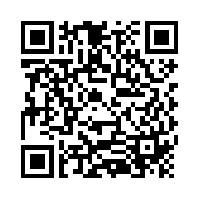
TELL US WHAT YOU THINK>>
Help us evaluate
Telling an Effective Success Story by visiting https://bit.ly/3DLndjY
or scanning the QR code!
Notes:
Drop the evaluation link in the chat

